Slide 1
ESTABLISHING
TRAUMA INFORMED & RESILIENCE FOCUSED CONGREGATIONS
Danielle Ratcliff
Certified Trauma & Resilience Trainer

Slide 2
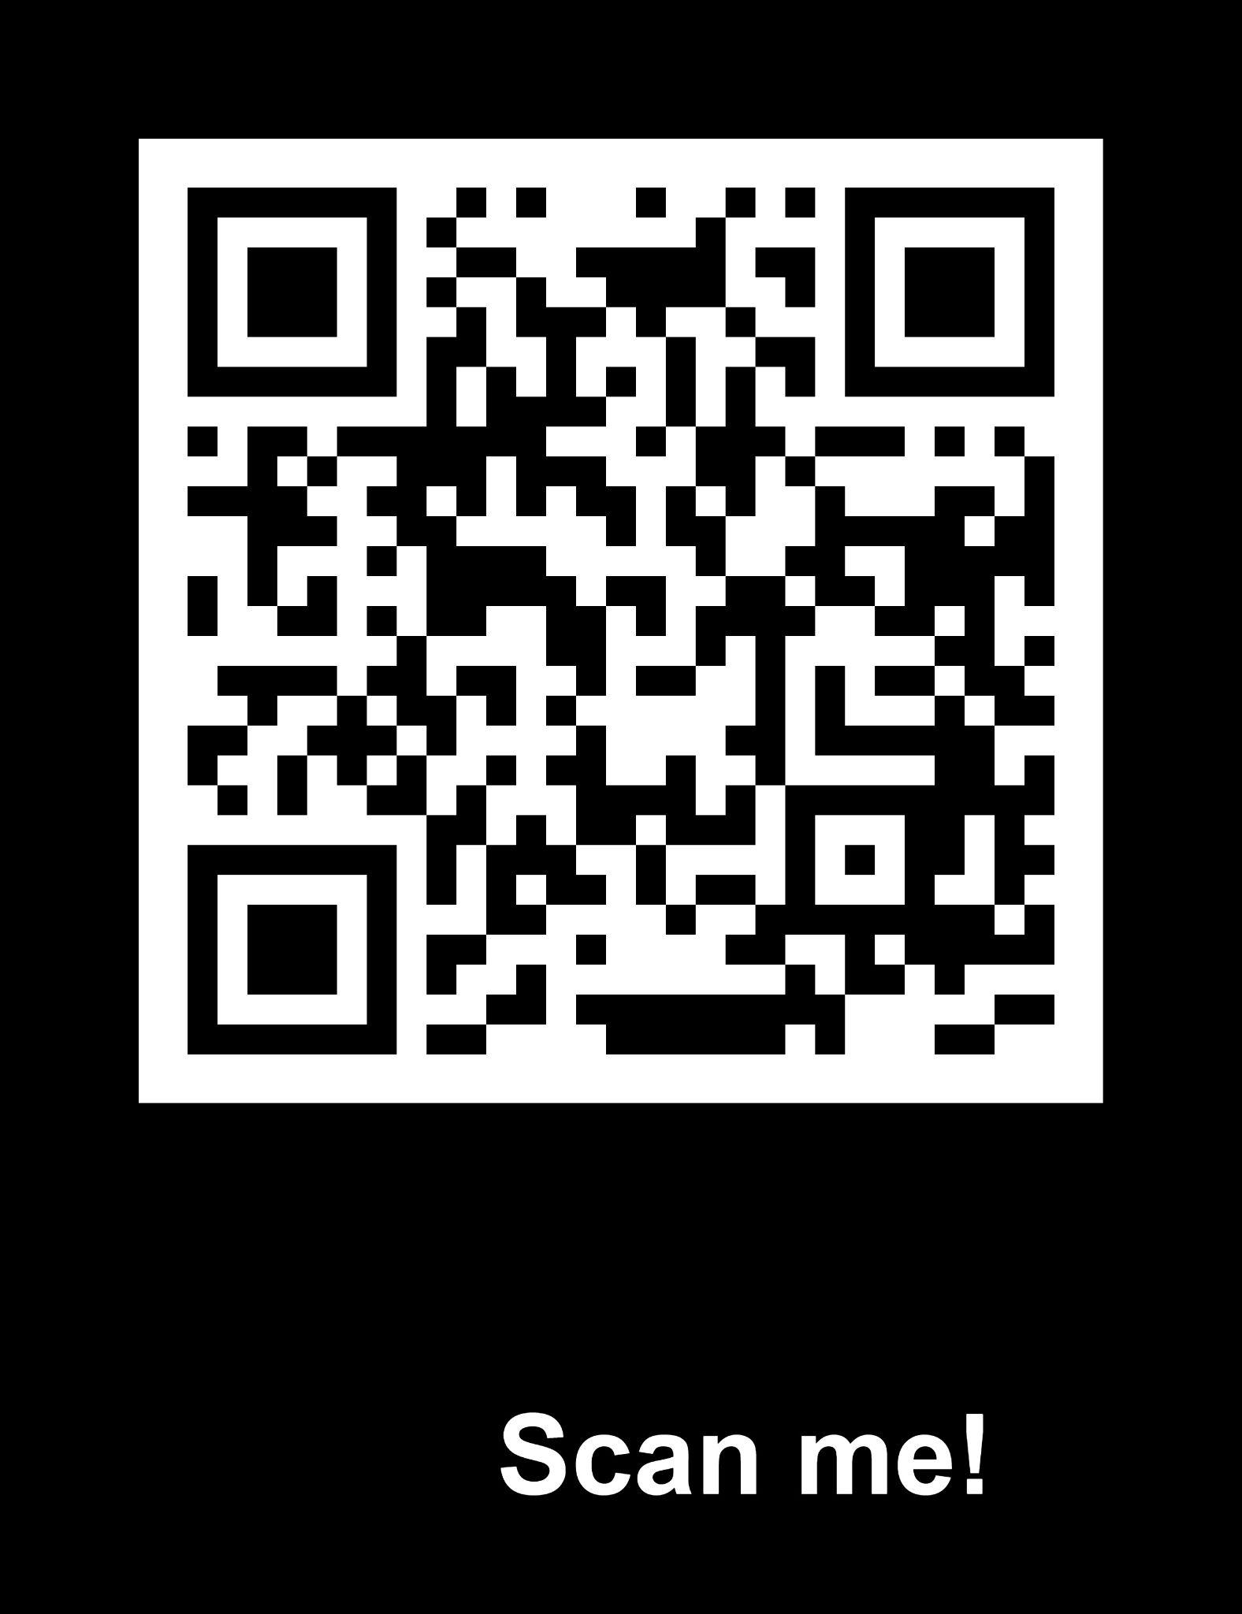
ACCESS TO PRESENTATION
PASSWORD: heretoheal
www.REACHforTomorrowOhio.org/TIRF-Congregations.html

Slide 3
OBJECTIVES
NEED - What is needed from a congregation to help in the Healing.
ACTION - What a congregation needs to do to Help them to Heal.
CHARACTER - What qualities a congregation needs to Help in
the Healing Process.

Slide 4
IT IS ALL ABOUT THE LENS WE LOOK AT
OURSELVES, OTHERS & THE WORLD AROUND US

Slide 5
TOPICS
What is a Trauma Informed Congregation?
The Lens of Trauma
Risk factors and Human Trafficking
Needs of the person experiencing Trauma for Healing
Actions of a Trauma Informed Resilience Focus Congregation to Help in the Healing
Characteristics or qualities needed to help in the Healing Process
Where do we go from here…

Slide 6
COLOSSIANS 3:12-14 The Passion Translation(TPT)
You are always and dearly loved by God! So ROBE yourself with virtues of God, ... Be MERCIFUL as you endeavor to UNDERSTAND others, and be COMPASSIONATE, showing kindness toward all. Be GENTLE and HUMBLE, UNOFFENDABLE in your PATIENCE with others. 13 TOLERATE the WEAKNESSES of those in the family of faith, FORGIVING one another in the same way you have been graciously forgiven by Jesus Christ. If you find fault with someone, release this same gift of forgiveness to them. 14 For LOVE is supreme and must flow through each of these virtues. LOVE becomes the mark of TRUE MATURITY.
Notes:
Ask the participants to get into groups. Each group is given a large piece of paper in which they are to draw an outline of one of the group in pencil. The groups are then asked to draw the garment that represents the Colossians 3:12-14 garment that they have just read about. Allow 20-30 minutes for this to happen, allowing them to have conversation about what they are putting in their garments. Or if done in an individual form have them draw glasses that represent the Colossians 3:12-14 garment (How to see the world through the Lord’s Lens)
NOTES:

Slide 7
WHAT IS A TRAUMA INFORMED CONGREGATION?
A congregation that seeks to understand the impact of trauma and know how to respond.
Notes:
They are seekers, listeners, educated

Slide 8
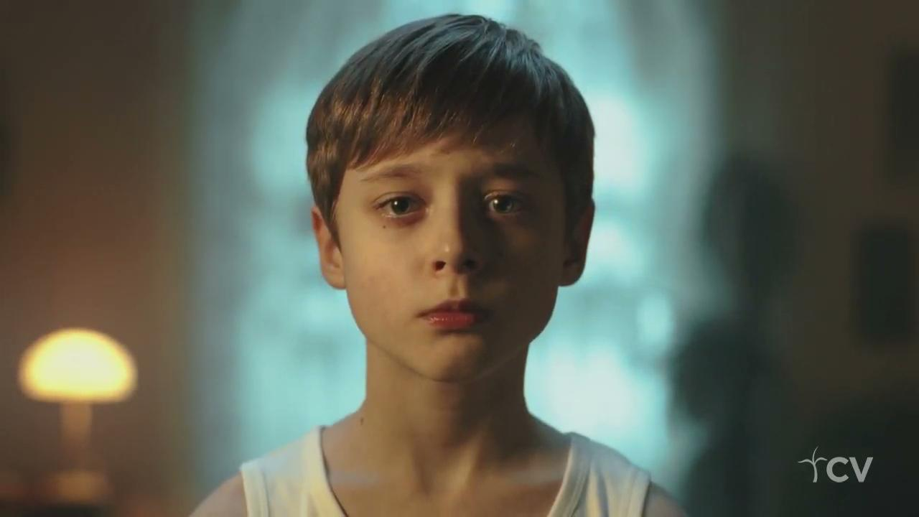

Slide 9
TRAUMA
Any experience that leaves a person feeling hopeless, helpless, fearing for their life/survival, or their safety. This experience can be REAL or PERCEIVED.
TLC Children of Trauma Presentation

Slide 10
Trauma reactions are no different following non-violent situations such as natural disasters, chronic illness, etc.
TLC Children of Trauma and Resilience Presentation

Slide 11
TRAUMA EXPOSURE
Victim (abuse, neglect, car accident)
Witness (personal witness – domestic violence, police, fire)
Related to (peer, siblings – of chronically ill siblings, sibling that completed suicide)
Listening to details of trauma (therapists, media exposure, video games, etc.)
TLC Children of Trauma & Resilience Presentation
Notes:
DSM 5 states that PTSD cannot come from TV, video or electronic means. It was the result of an interpersonal relationship. TLC still believes it is important to pay attention to media exposure/video games etc. because it may still be activating for that child.

Slide 12
Posttraumatic Stress Disorder (DSM 5)
Re-experiencing (INTRUSION – 1) | Avoidance (NUMBING - 1) | Negative Cognitions and Mood (2) | Arousal (2)
Flashbacks | Detachment | Distorted sense of self | Aggression
Intrusive thoughts -images | Numbing | Estrangement to others | Reckless behavior
Traumatic dreams | OCD like behavior Phobic like behavior | Markedly diminished interest | Self-destructive and Rule-breaking behaviors
Sleep problems | Self Harm | Depression | Hypervigilance
Physical complaints | Substance Abuse | Blames self or others | Irritability
 | Eating Disorders |  | Inattention
 | Not wanting to talk about it |  | Cognitive/Learning problems
TLC Children of Trauma & Resilience Presentation
©2014 Starr Commonwealth. Not to be reproduced or distributed without prior written consent from Starr Commonwealth

Slide 13
Symptom Overlap (Weinstein et al., 2000) | ADHD | PTSD
Hypervigilence | X | X
Inattention | X | X
Detachment | X | X
Irritability | X | X
Anger Outbursts | X | X
Distracted | X | X
Restless | X | X
Impatient | X | X
Impulsive | X | X
Limited sense of future | X | X
Difficulty Concentrating | X | X
TLC Children of Trauma & Resilience Presentation

Slide 14
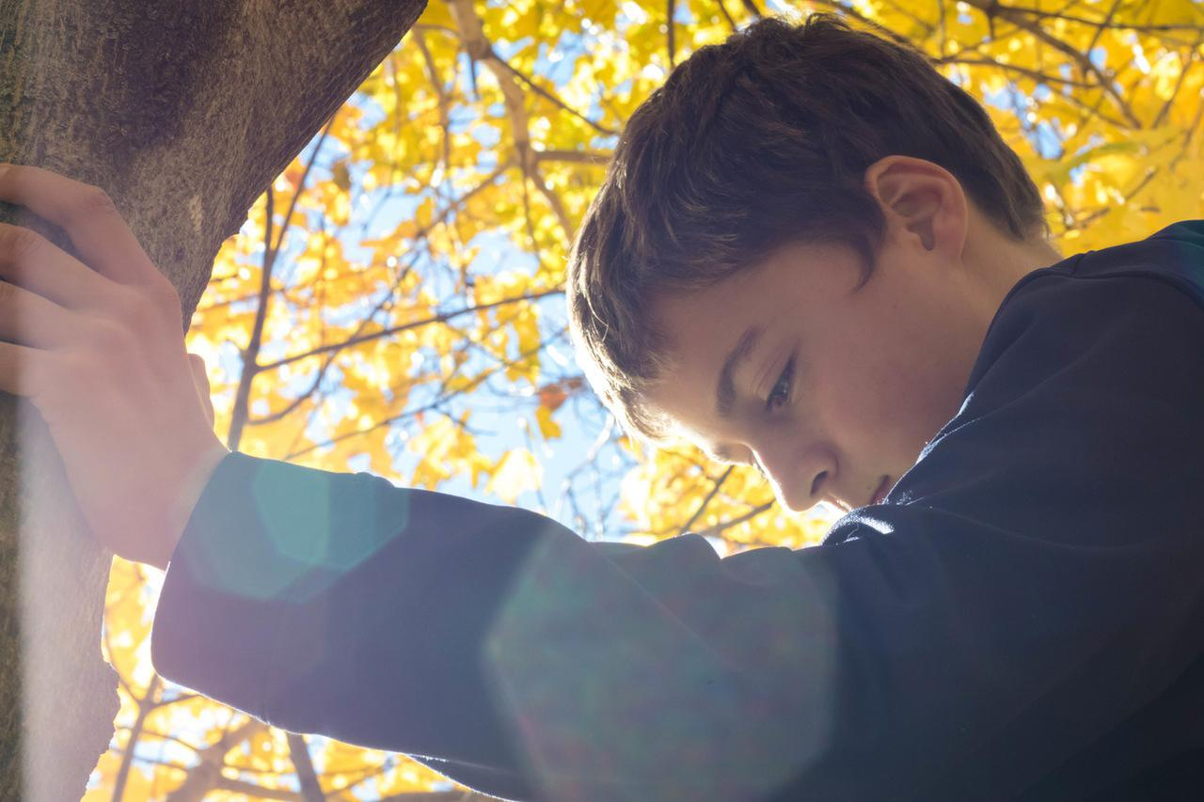
Trauma Focused Mandate
The primary dictate of trauma informed care is:
“Do No Harm”
If you don’t think what I think, feel what I feel, experience what I experience, and see what I see when I look at myself, others, and the world around me, how can you possibly know what is best for me?
TLC Children of Trauma & Resilience Presentation

Slide 15
Trauma is a sensory experience because of what happens to the brain and memory during trauma.
TLC Children of Trauma & Resilience Presentation

Slide 16
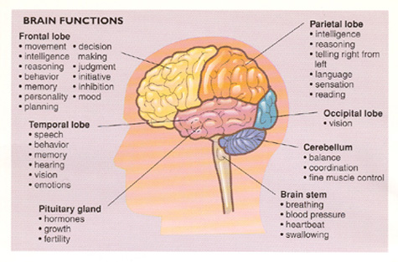
Functions of the Brain
Right Brain (Sensory) | Left Brain (Thinking)
Senses | Language
Memory | Reasoning
Affect | Thinking
Emotional Regulation | Understanding/Processing
TLC Children of Trauma Presentation
©2014 Starr Commonwealth. Not to be reproduced or distributed without prior written consent from Starr Commonwealth

Slide 17
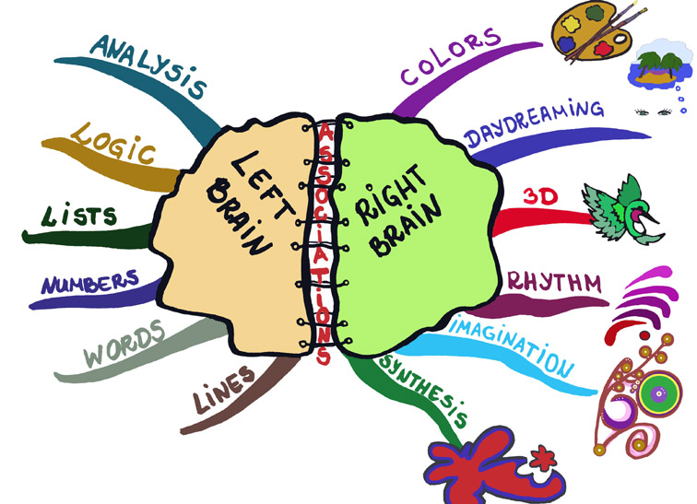
Left Brain and Right Brain
Both brain hemispheres are affected.
The first thing that happens is that the left and right brain don’t integrate and work together – There is no cooperation between the two hemispheres.
TLC Children of Trauma Presentation

Slide 18
How Trauma Impacts Left Brain
No language.
No reasoning skills.
Unable to make sense out of what happened.
The neurons in the Hippocampus are damaged significantly by the stress hormone release.
Learning, processing, focusing is impaired.
TLC Children of Trauma Presentation
©2014 Starr Commonwealth. Not to be reproduced or distributed without prior written consent from Starr Commonwealth

Slide 19
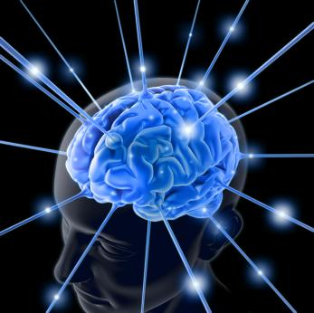
Experience becomes Biology
Though it may be difficult to believe, one traumatic event in any one’s life, especially a child’s, can alter both the structure and the chemistry of the brain.
TLC Children of Trauma & Resilience Presentation

Slide 20
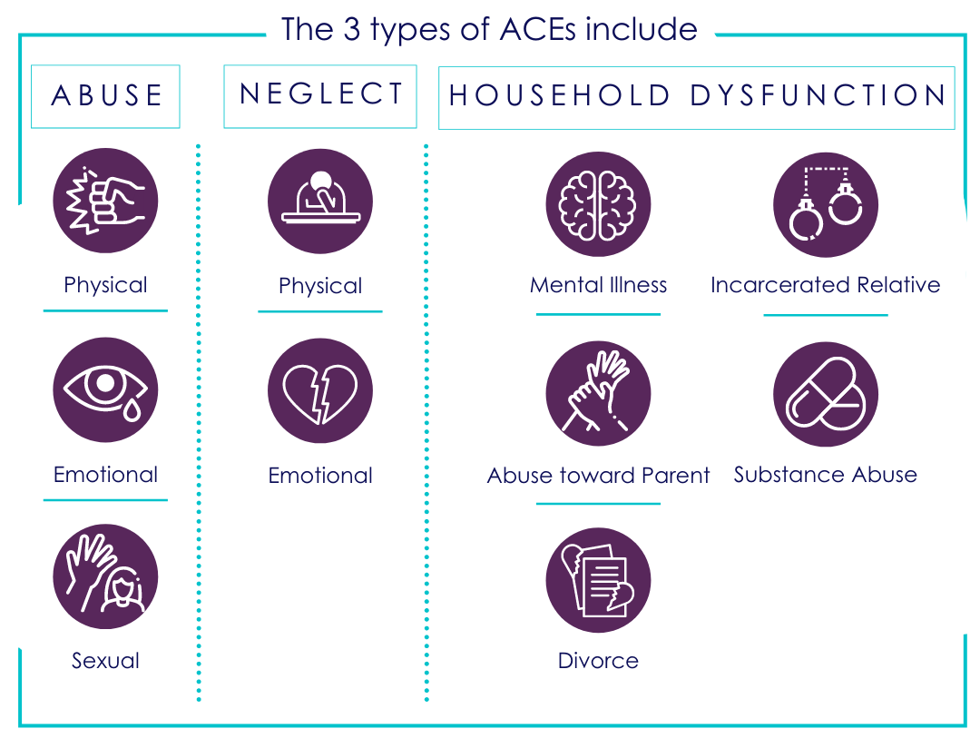
ADVERSE CHILDHOOD EXPERIENCES STUDY
Notes:
Ask the participants to close their eyes and think of their Family and who may have 1 or more ACES, then think of friends and who may have ..., then people in their church and who may have… Ask they to pick a color on the the ones who have experienced 1 or more ACE and the pick another color for the ones they know who have not. Ask them to place them in a pie chart representing the amount who have and have not experienced 1 or more ACES. Ask them to open their eyes and ask the class to put their hand up if their whole pie was the color of none had experienced 1 or more, then continue in quarterly increments until you ask about a pie that is fully the color of people with 1 or more ACES. Process this with the participants stressing the need to be aware of the impact of trauma and how we as a congregation through 3-4-7 can do this.

Slide 21
What color is your congregation?
Notes:
Ask the participants to close their eyes and think of their Family and who may have 1 or more ACES, then think of friends and who may have ..., then people in their church and who may have… Ask they to pick a color on the the ones who have experienced 1 or more ACE and the pick another color for the ones they know who have not. Ask them to place them in a pie chart representing the amount who have and have not experienced 1 or more ACES. Ask them to open their eyes and ask the class to put their hand up if their whole pie was the color of none had experienced 1 or more, then continue in quarterly increments until you ask about a pie that is fully the color of people with 1 or more ACES. Process this with the participants stressing the need to be aware of the impact of trauma and how we as a congregation through 3-4-7 can do this.

Slide 22
RISK FACTORS OF BECOMING A VICTIM OF HUMAN TRAFFICKING
Prior Abuse or Neglect
Poverty
Homelessness
Substance Abuse
Unaccompanied Foreign Minors
Mental Health Issues
System Involvement
Feelings of Rejection or Marginalization.
TLC Children of Trauma & Resilience Presentation
©2014 Starr Commonwealth. Not to be reproduced or distributed without prior written consent from Starr Commonwealth
Notes:
Prior Abuse or Neglect – Prior abuse or neglect heighten a child’s vulnerability to sex trafficking.
Poverty – Poverty is closely linked to vulnerability. A lack of access to resources and income opportunities limits options for impoverished people, making them more susceptible to traffickers who prey on those needs.
Homelessness – As previously mentioned, NCMEC found that 1 in 6 runaway and homeless youth reported to NCMEC were likely victims of child sex trafficking. A study conducted by Safe Horizon of homeless youth in New York City found that 95% of homeless youth reported being sexually active and were more likely to engage in survival sex in exchange for money, shelter, food, or other necessities.
Substance Abuse – Substance abuse, along with other high-risk behaviors, puts youth at risk for human trafficking. Anti-trafficking advocates have seen cases where addiction was used as a control mechanism by traffickers to coerce and force their victims into engaging in commercial sex against their will.
Unaccompanied Foreign Minors – Foreign national youth who are smuggled into the U.S. are at increased risk of being trafficked on their journey to the United States. Separation from parents leaves these minors without the usual safety nets that can prevent and respond to potential trafficking situations. Without these resources, these youth may not know where to find help or feel comfortable accessing it.
Mental Health Issues – Unresolved mental health issues can both put youth at risk and be a direct consequence of the traumatic experience of being trafficked.
System Involvement – There are often prior histories of abuse, neglect, or delinquent behavior for youth involved in the child welfare, foster care, or the juvenile justice systems that heighten their vulnerability. These types of violence might be normalized, and the adults that are responsible for protecting these children may fail to intervene and stop these harmful behaviors. The resulting lack of trust in authority figures puts the youth at increased risk for recruitment.
Feelings of Rejection or Marginalization – A study conducted by the John Jay College of Criminal Justice (2008) found that fewer than 10% of the interviewed youth who had been commercially sexually exploited said they could turn to a parent if they found themselves in trouble. Youth in foster care who identify as gay, lesbian, bisexual, or transgender have reported harassment by other foster care youth, discomfort or rejection among foster parents or child welfare staff, and increased challenges accessing appropriate services.

Slide 23
LGBTQ+ YOUTH
40% higher risk of experiencing homelessness.
40% higher risk of attempting suicide & account for 30% of all suicides.
28% higher risk of dropping out of school.
In daily life hear 26 anti-LGBTQ+ slurs per day, 33% are from adults in their life.
74 - 84% are verbally and sexually abused at school.

Slide 24
REFLECTION - WHO DO THEY SEE - WHO DO YOU SEE?
Matthew 7 : 1-5
Matthew 1 : 12-14
Notes:
Do Not Judge
1“Refuse to be a critic full of bias toward others, and you will not be judged. 2For you’ll be judged by the same standard that you’ve used to judge others. The measurement you use on them will be used on you. 3Why would you focus on the flaw in someone else’s life and fail to notice the glaring flaws of your own? 4How could you say to your friend, ‘Let me show you where you’re wrong,’ when you’re guilty of even more? 5You’re being hypercritical and a hypocrite! First acknowledge and deal with your own ‘blind spots,’ and then you’ll be capable of dealing with the
‘Blind spot’ of your friend.
The Golden Rule
12“In everything you do, be careful to treat others in the same way you’d want them to treat you, for that is the essence of all the teachings of the Law and the Prophets.13 Enter through the narrow gate because the wide gate and broad path is the way that leads to destruction—nearly everyone chooses that crowded road! 14The narrow gate and the difficult way leads to eternal life—so few even find it!”

Slide 25
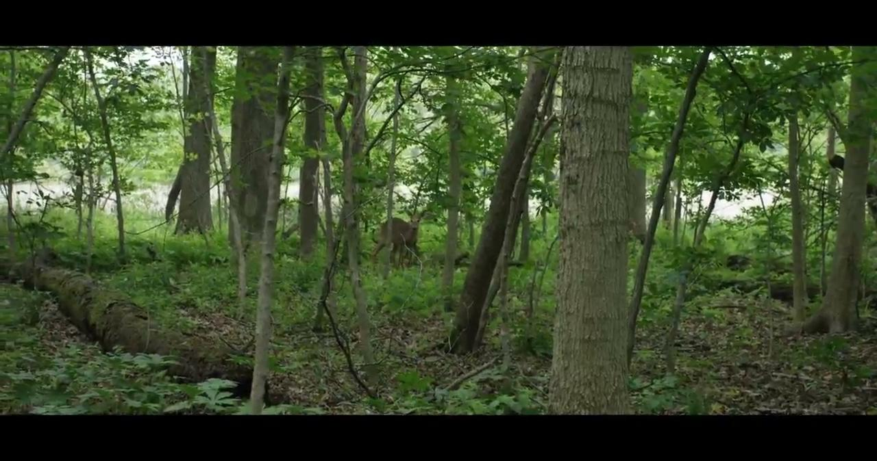
CORY’S STORY

Slide 26
REFLECTION OF CORY’S STORY
How had Cory’s childhood trauma impacted him?
Did his experiences go away when he became an adult?
What may be some of Cory’s triggers?
Because of Cory’s past trauma what may be difficult for him in being part of a congregation?
How do we as a congregation create a safe environment for people who are or have experienced trauma?

Slide 27
Titus 3:4-7
4 When the extraordinary compassion of God our Savior and his overpowering love suddenly appeared in person, as the brightness of a dawning day,
5 He came to save us. Not because of any virtuous deed that we have done but only because of his extravagant mercy.
6 He saved us, resurrecting us through the washing of rebirth. We are made completely new by the Holy Spirit, whom he splashed over us richly by Jesus, the Messiah, our Life Giver.
7 So as a gift of his love, and since we are faultless— innocent before his face— we can now become heirs of all things, all because of an overflowing hope of eternal life.
Notes:
Titus 3:4-7
4 But when God, our kind and loving Savior God, stepped in,5 he saved us from all that. It was all his doing; we had nothing to do with it. He gave us a good bath, and we came out of it new people, washed inside and out by the Holy Spirit.6 Our Savior Jesus poured out new life so generously.7 God's gift has restored our relationship with him and given us back our lives. And there's more life to come - an eternity of life!

Slide 28
Titus 3:4-7
3
NEEDS
For people experiencing trauma to see in a Congregation
4
ACTIONS
Congregations need to do to help in Healing
7
CHARACTERISTICS
Qualities Congregations need to help in the Healing process
Notes:
Titus 3:4-7
4 But when God, our kind and loving Savior God, stepped in,5 he saved us from all that. It was all his doing; we had nothing to do with it. He gave us a good bath, and we came out of it new people, washed inside and out by the Holy Spirit.6 Our Savior Jesus poured out new life so generously.7 God's gift has restored our relationship with him and given us back our lives. And there's more life to come - an eternity of life!

Slide 29
TRAUMA INFORMED CONGREGATIONS
3-4-7

Slide 30
3 NEEDS
SAFE TRUSTWORTHY RELATIONSHIPS
OPPORTUNITIES FOR SELF REGULATION
SHARING LIFE STORIES HONESTLY
Notes:
For a Church to be considered a safe place to a person who has experienced trauma it needs to offer 3 things:
It is a place that cultivates safe trustworthy relationships. It has an atmosphere of relaxation and places for self regulation. That opportunities are offered to share their life story in safe supported environment.

Slide 31
4 ACTIONS
REALIZE (Become Aware)
RECOGNIZE (the Ripples from Trauma)
RESPOND (Integrating trauma into policies, procedures, and practices)
RESIST RE-TRAUMATIZATION (Operate through a Trauma Lens)
Notes:
Actions in which congregations need to take to become trauma informed are:
We can’t change anything until we become aware. Acknowledging that trauma has an impact on us not just emotionally but also cognitively. Our brain is changed due to the high stress.
Recognize that there are ripple effects because of trauma we experience. Recognize the symptoms of trauma.
Respond to others using the 7 characteristics of a trauma informed congregations.
Resist Re-Traumatizing use the tools you are given, wear the garment the Lord has given you and look through a trauma lens.

Slide 32
7 CHARACTERISTICS
Acknowledge
Recognize the Impact of Trauma
Perspective Shift
Self Regulation
5. Sustain Relationships
6. Sense of Purpose
7. Ongoing Self Care

Slide 33
ACKNOWLEDGE
To Acknowledge The Impact Of Trauma On An Individual - We First Need To Acknowledge That Trauma Is Real And How It Affects Us.

Slide 34
2. RECOGNIZE THE IMPACT
Recognize the impact Adverse Experiences have on us and how those experiences can have the ripple effect on our health, social skills and mental health.

Slide 35
3. PERSPECTIVE SHIFT
Our perspective needs to shift. We need to see the people around us through the lens of trauma, not asking “What is wrong with you?” But “ What happened to you or what is happening to you?”

Slide 36
4. SELF REGULATION
We need to be a Colossians 3 Christian, wearing the garment of compassion, kindness, humility, quiet strength, discipline. Be even-tempered, content with second place, quick to forgive an offense. Forgive as quickly and completely as the Master forgave you.
Notes:
To become a congregation that is trauma informed and believes in doing no harm, we need to first take responsibility for US. Becoming more aware of our own coping behaviors that may be triggers to another's traumatic event.

Slide 37
5. Sustain Relationships
We need to be a congregation that is not just a Sunday and maybe Wednesday night church. Willing to take our masks down and welcome others to get to know the real us. We need to be authentic/real.
Notes:
Play Rat Park Video

Slide 38
6. SENSE OF PURPOSE
John 13:34 - Love One Another
Galatians 6:10 - Do good to all people
Galatians 5:13 - Serve One Another
Galatians 6:2 - Carry Each Other’s Burdens
Romans 15:7 - Accept One Another
Ephesians 4:32 - Compassion & Forgiveness

Slide 39
7. ON GOING SELF CARE
THE B’S OF A HEALTHY YOU
BE AWARE - of what is happening to you.
BOUNDARIES - are for you too.
BODY-MIND-SPIRIT it takes all three.
BE HAPPY - you deserve it

Slide 40
WHAT COMES NEXT?

Slide 41
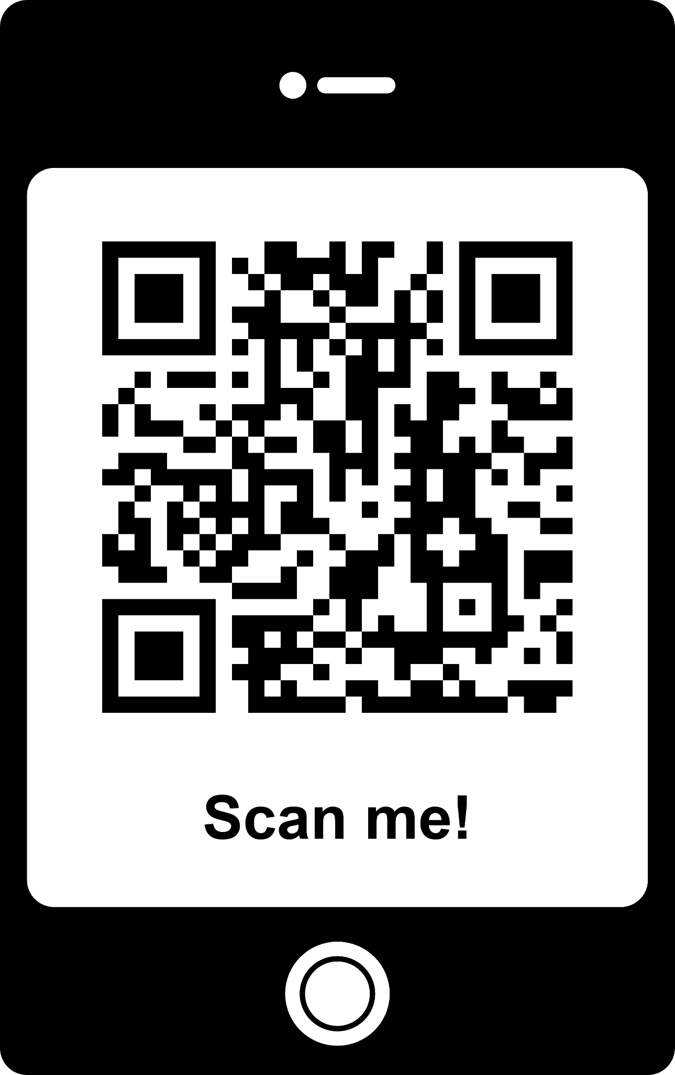
MATTHEW 7:12 TOOLBOX
www.REACHforTomorrowOhio.org/MAT712-toolbox.html

Slide 42
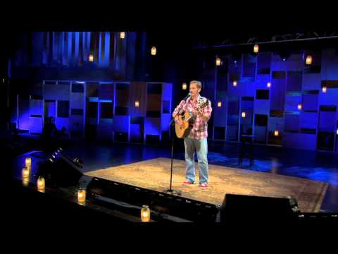

Slide 43
REFERENCES
http://www.reachfortomorrowohio.org/mat712-toolbox.html
https://www.starr.org/training/tlc/courses-training
https://www.gci.org/disc/23-functions - purpose of the church
http://www.ictg.org/blog/seven-key-traits-of-a-trauma-informed-congregation - 7 traits/characteristics
https://www.womenshealth.gov/blog/trauma-informed-congregations - 4 R's of a trauma informed congregation
http://www.acesconnection.com/g/faith-based-connection/search/tag/442378480397913552
https://vimeo.com/137282528 - resilience film
https://www.youtube.com/watch?v=v7stze3645s
https://www.youtube.com/watch?v=w0iVTQS8ftghttp://wwhttps://www.youtube.com/watch?v=w0iVTQS8ftgw.goodtherapy.org/blog/134-activities-to-add-to-your-self-care-plan/
https://www.youtube.com/watch?v=GYv4Fs7nzIY

